Slide 1

18ECC303J – Computer Communication Networks
Course Credit : 4
Theory : 9 Hours
1. Behrouz A. Forouzan, “Data communication & Networking”, Mc-Graw Hill, 5th Edition Reprint, 2014.
2. Andrew S. Tanenbaum, “Computer Networks”, Pearson Education India, 5th Edition, 2013.
3. William Stallings, “Data & Computer Communication”, Pearson Education India, 10th Edition, 2014.

Slide 2
Unit 1 – Data Communication and Networking Basics
Introduction to Data Communication and Networking
Data transfer modes-Serial and Parallel transmission
Protocols & Standards
Layered Architecture; Principles of Layering & Description
Brief description of concepts in OSI & TCP/IP model
Switching Types: Circuit & Packet switching, Message switching, Comparison of switching types
LAN, MAN & WAN
Network topologies-Types, Comparison of topologies
IEEE standards for LAN-Ethernet; Types of Ethernet
Token Bus, Token Ring and FDDI

Slide 3

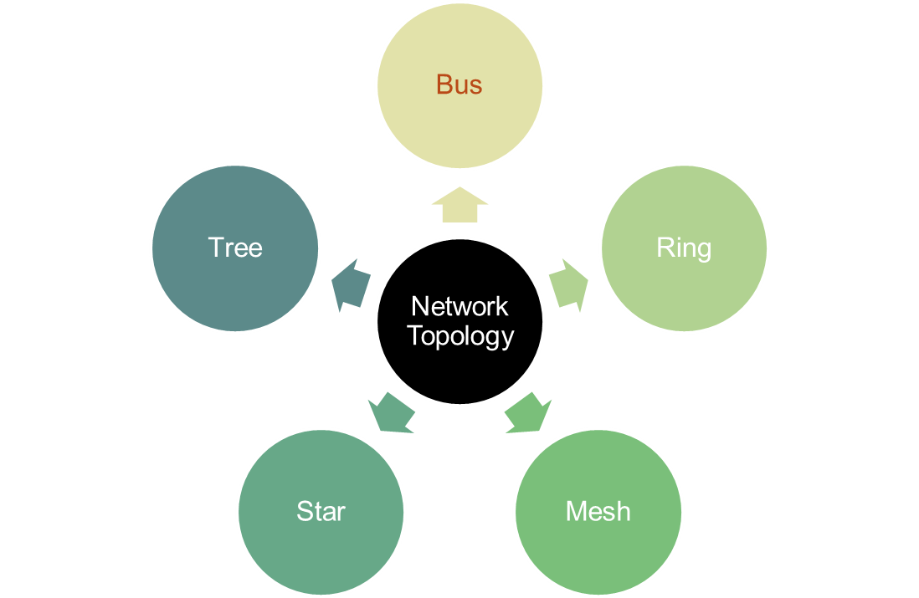
Unit 1 – Week 2-Review
Key Parameters | LAN | MAN | WAN
Ownership | private | private or public. | private or public.
Speed | quiet high. | average. | speed is lower than that of LAN.
Delay | short. | moderate. | longer.
Congestion | Low | High | Higher
Fault Tolerance | s higher than WAN. | lower than LAN. | lower than both LAN and MAN.
Maintenance | easy and less costly than WAN. | complex and more costly than LAN. | complex and more costly than both.
Switching Types
Circuit Switching
Packet Switching
Message Switching
Virtual Circuit Switching
Datagram Packet Switching

Slide 4
Unit 1 – Week 3
Session 7
IEEE standards for LAN-Ethernet
Types of Ethernet
Session 8
Token Bus
Token Ring
Session 9
FDDI
Reference Text Books:
1. Behrouz A. Forouzan, “Data communication & Networking”, Mc-Graw Hill, 5th Edition Reprint, 2014.
2. Andrew S. Tanenbaum, “Computer Networks”, Pearson Education India, 5th Edition, 2013.

Slide 5
Introduction to Data Communication and Networking
Objectives :
To Introduce the students about IEEE standards for LAN-Ethernet; Types of Ethernet, Token Bus, Token Ring and Fiber Distributed Data Interface (FDDI)
The main objective of data communication and networking is to enable seamless exchange of data between any two points in the world.
This exchange of data takes place over a computer network.
To understand the concepts of various switching techniques, types of networks and topology.
To gain knowledge on IEEE standards for LAN.

Slide 6
IEEE Standards for LAN
IEEE 802.3 and Ethernet
Very Popular LAN Standard
A Standard for 1-persistent CSMA/ CD LAN (Carrier Sense Multiple Access/ Collison Detection)
Covers the physical layer and MAC sublayer protocols
In 1985, the Computer Society of the IEEE started a project, called Project 802, to set standards to enable intercommunication among equipment from a variety of manufacturers.
Project 802 is a way of specifying functions of the physical layer and the data link layer of major LAN protocols.
Notes:
Ethernet and IEEE 802.3 are distinct standards but as they are very similar to one another these words are used interchangeably.
1-persistent: When a station has data to send, it first listens to the channel to see if anyone else is transmitting at that moment. If the channel is busy, the station waits until it becomes idle. When the station detects an idle channel, it transmits a frame. If a collision occurs, the station waits a random amount of time and starts all over again. The protocol is called 1-persistent because the station transmits with a probability of 1 when it finds the channel idle

Slide 7
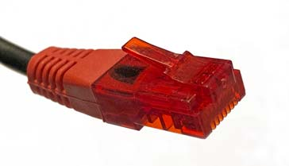
IEEE Standards for LAN – Ethernet
Physical Layer LAN technology
The original Ethernet was created in 1976 at Xerox's Palo Alto Research Center (PARC).
Xerox built a 2.94 Mbps CSMA/CD system to connect over 100 personal workstations on 1-Km cable. This system was called Ethernet through which electromagnetic radiation was once thought to propagate.
Xerox DEC and Intel came with another standard for 100 Mbps Ethernet.
Ethernet RJ45 connector on an Ethernet cable
Ethernet, IEEE 802.3 has been in use for many years and provides wired connectivity for many data networking applications from home to the largest enterprise systems

Slide 8
Ethernet Evolution
Ethernet Evolution
Standard Ethernet
Fast Ethernet
Gigabit Ethernet
Ten-Gigabit Ethernet
10 Mbps
100 Mbps
1 Gbps
10 Gbps
Gigabit Ethernet also known as “gigabit-Ethernet-over-copper” or 1000Base-T or GigE
10 Gigabit Ethernet is based entirely on the use of optical fiber connections.
Other LAN types include Token Ring, Fiber Distributed Data Interface (FDDI), Asynchronous Transfer Mode (ATM) and LocalTalk

Slide 9
Categories of Standard Ethernet
Standard Ethernet Common Implementation
10Base2
10Base-T
10Base5
10Base-F
Bus
Thick Coaxial
Bus
Thin Coaxial
Star
UTP
Star
Fiber
10 denotes 10 Mbps
Base represents Baseband
5 represents 500 m
2 denotes 200/185 m
T means Twisted Pair Cable
F means Fiber.
Notes:
The Standard Ethernet defines several physical layer implementations; four of the most common: 10Base5, 10Base2, 10Base-T and 10Base-F
Standard Ethernet Code
In order to understand standard Ethernet code, one must understand what each digit means. Following is a guide:
Guide to Ethernet Coding
10at the beginning means the network operates at 10Mbps.
BASE means the type of signaling used is baseband.
2 or 5 at the end indicates the maximum cable length in meters.
T the end stands for twisted-pair cable.
X at the end stands for full duplex-capable cable.
FL at the end stands for fiber optic cable
.For example: 100BASE-TX indicates a Fast Ethernet connection (100 Mbps) that uses a twisted pair cable capable of full-duplex transmissions.

Slide 10
Ethernet Specifications
Name | Cable | Max seg. (m) | Nodes per segment | Advantages
10Base5 | thick coax | 500 | 100 | The Original
10Base2 | thin coax | 185 | 30 | No hub
10Base-T | twisted pair (UTP) | 100 | 1024 | Low Cost
10Base-F | fiber | 2000 | 1024 | Long distance

Slide 11
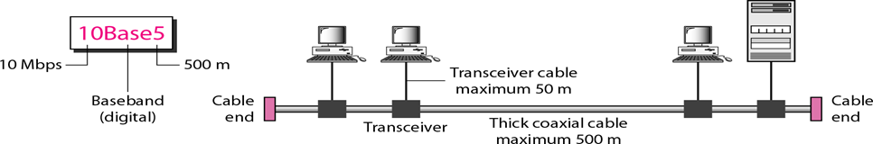
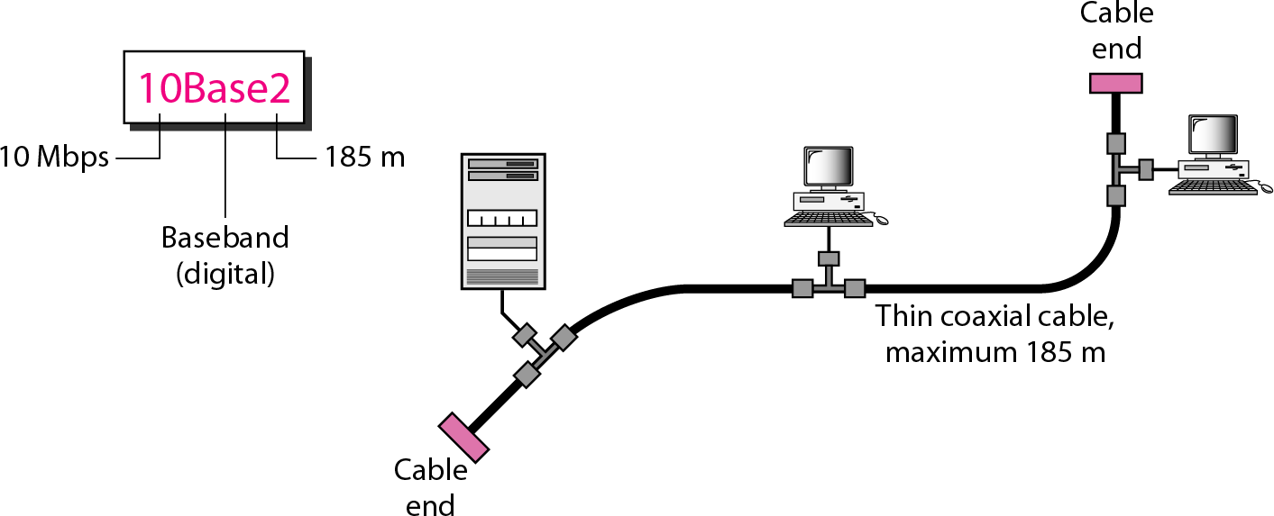
Ethernet Cabling
10Base5
Thick Ethernet or Thicknet
First Ethernet - to use a bus topology with an external transceiver connected via a tap to a thick coaxial cable.
10Base2
Thin Ethernet or Cheapernet
.
The transceiver is responsible for transmitting, receiving, and detecting collisions.
The transceiver is connected to the station via a transceiver cable that provides separate paths for sending and receiving
This means that collision can only happen in the coaxial cable.
The maximum length of the coaxial cable must not exceed 500 m
10Base2 also uses a bus topology, but the cable is much thinner and more flexible.
The cable can be bent to pass very close to the stations.
In this case, the transceiver is normally part of the network interface card (NIC), which is installed

Slide 12
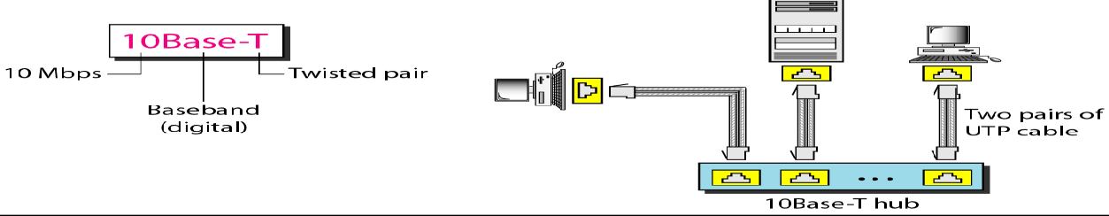
Ethernet Cabling
10Base - T: Twisted pair ethernet
10Base-T uses a physical star topology.
10Base - F: Fiber Ethernet
Although there are several types of optical fiber 10-Mbps Ethernet, the most common is called 10Base-F.
Two pairs of twisted cable create two paths (one for sending and one for receiving) between the station and the hub. Any collision here happens in the hub.
Compared to 10Base5 or 10Base2, we can see that the hub actually replaces the coaxial cable as far as a collision is concerned.
The maximum length of the twisted cable here is defined as 100 m, to minimize the effect of attenuation in the twisted cable.
The stations are connected to the hub using two fiber-optic cables.
10Base-F uses a star topology to connect stations to a hub.

Slide 13
Types of Ethernet
Fast Ethernet - IEEE 802.3u
Fast Ethernet was designed to compete with LAN protocols such as FDDI or Fiber Channel.
Gigabit Ethernet – IEEE 802.3z
The need for an even higher data rate resulted in the design of the Gigabit Ethernet protocol (1000 Mbps).
Fast Ethernet is backward-compatible with Standard Ethernet, but it can transmit data 10 times faster at a rate of 100 Mbps.
Ten-Gigabit Ethernet – IEEE 802.3ae
The IEEE committee created Ten-Gigabit Ethernet and
called it Standard 802.3ae
Goals:
Upgrade the data rate to 100 Mbps.
Make it compatible with Standard Ethernet.
Keep the same 48-bit address and same frame format.
Keep the same minimum and maximum frame lengths.
Goals:
Upgrade the data rate to 1 Gbps.
Make it compatible with Standard or Fast Ethernet.
Use the same 48-bit address and same frame format.
Keep the same minimum and maximum frame lengths.
Goals:
Upgrade the data rate to 10 Gbps.
Compatible with Standard, Fast, and Gigabit Ethernet.
Use the same 48-bit address and the same frame format.
Keep the same minimum and maximum frame lengths.
Allow the interconnection of existing LANs into a MAN or WAN
Make Ethernet compatible with technologies such as Frame Relay and ATM.

Slide 14
Fast Ethernet - Classification
100Base-TX
It uses two pairs of twisted-pair cable (either category 5 UTP or STP(Shielded twisted pair).
100Base-FX
Uses two pairs of fiber-optic cables.
100Base-T4
Uses four pairs of category 3 or higher UTP.(not cost efficient compared to Category 5)
For this implementation, the MLT-3(Multi Level Transmit) scheme was selected since it has good bandwidth performance.
4B/5B block coding is used to provide bit synchronization by preventing the occurrence of a long sequence of 0s and 1s. This creates a data rate of 125 Mbps, which is fed into MLT-3 for encoding.
Optical fiber can easily handle high bandwidth requirements by using simple encoding schemes.
Uses NRZ-I(Non-Return-to-Zero Inverted) encoding scheme ( bit synchronization problem.)
To overcome this problem, 4B/5B block coding is used.
It is cost effective
Transmit 100 Mbps.
Main Purpose of Autonegotiation
1. To allow incompatible devices to connect to one another.
2. To allow one device to have multiple capabilities.
3. To allow a station to check a hub's capabilities
Autonegotiation: A new feature of Fast Ethernet. It allows a station or a hub a range of capabilities, mode or data rate of operation.
Notes:
Guide to Ethernet Coding
10at the beginning means the network operates at 10Mbps.
BASE means the type of signaling used is baseband.
T the end stands for twisted-pair cable.
X at the end stands for full duplex-capable cable.
FL at the end stands for fiber optic cable

Slide 15
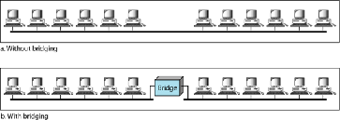
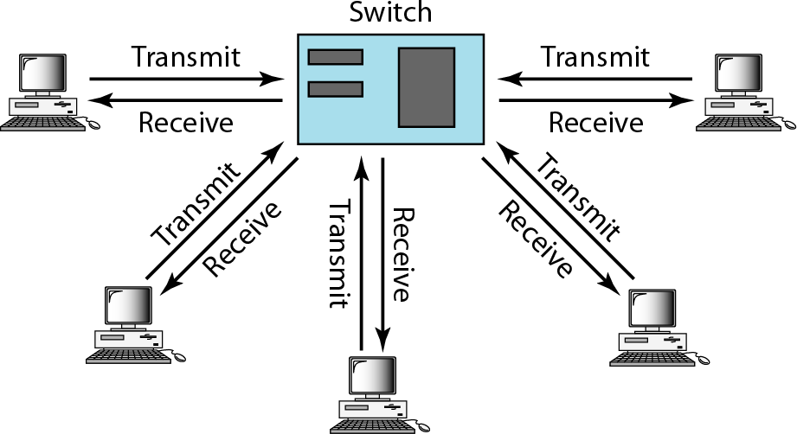
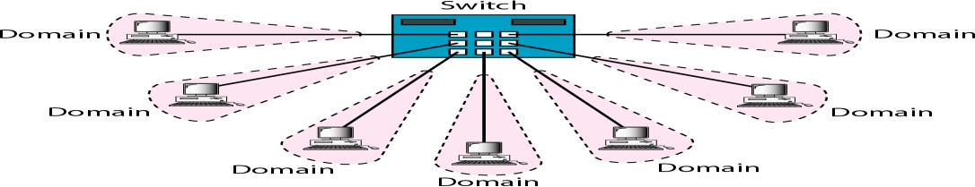
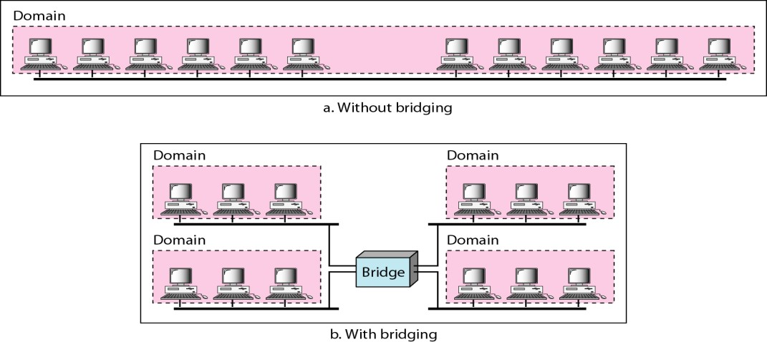
Changes in the Standard
Bridged Ethernet
The first step in the Ethernet evolution was the division of a LAN by bridges.
Without bridges, all the stations share the bandwidth of the network
Bridges have two effects on an Ethernet LAN:
1. Raising the bandwidth
2. Separate collision domains
Full Duplex Ethernet
In full duplex switch there are two links, one for sending and one for receiving,
No collision – CSMA/CD not required.
Increases the capacity of each domain from 10 to 20 Mbps
Switched Ethernet
A network switch is a small hardware device that joins multiple computers together within one local area network

Slide 16
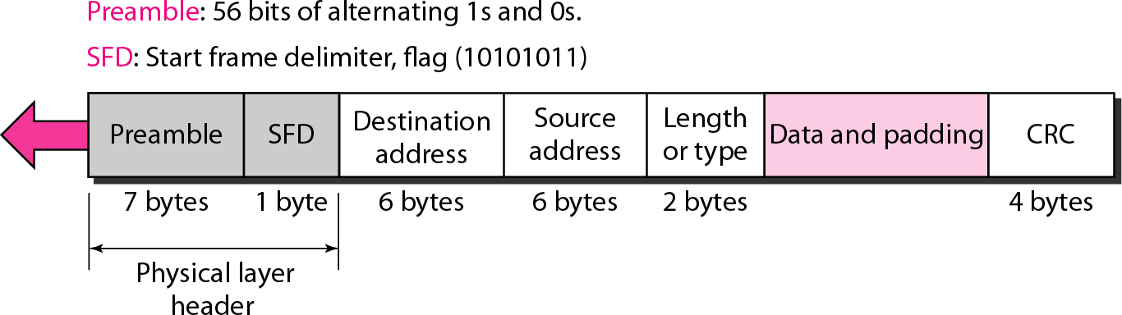
Frame Format – Standard Ethernet
Destination address (DA)
The DA field is 6 bytes
Contains the physical address of the destination station or stations to receive the packet.
Source address (SA)
It is 6 bytes
Contains the physical address of the sender of the packet.
Length or Type.
The original Ethernet - type field to define the upper-layer protocol using the MAC frame.
The IEEE standard - length field to define the number of bytes in the data field.
Data.
Carries data encapsulated from the upper-layer protocols. It is a minimum of 46 and a maximum of 1500 bytes.
CRC.
Contains error detection information, CRC-32
Preamble.
Contains 7 bytes (56 bits) of alternating 0s and 1s
Alerts the receiving system to the coming frame and enables it to synchronize its input timing. The pattern provides only an alert and a timing pulse
Start Frame Delimiter (SFD).
The second field (l byte: 10101011) signals the beginning of the frame.
Warns the station about the last chance for synchronization.
The last 2 bits is 11 and alerts the receiver that the next field is the destination address
Notes:
Preamble.
The first field of the 802.3 frame contains 7 bytes (56 bits) of alternating 0s and 1s that alerts the receiving system to the coming frame and enables it to synchronize its input timing.
The pattern provides only an alert and a timing pulse. The preamble is actually added at the physical layer and is not (formally) part of the frame.
Start frame delimiter (SFD).
The second field (l byte: 10101011) signals the beginning of the frame.
The SFD warns the station or stations that this is the last chance for synchronization. The last 2 bits is 11 and alerts the receiver that the next field is the destination address.
Destination address (DA). T
he DA field is 6 bytes and contains the physical address of the destination station or stations to receive the packet.
Source address (SA).
The SA field is also 6 bytes and contains the physical address of the sender of the packet.
Length or type. T
his field is defined as a type field or length field. The original Ethernet used this field as the type field to define the upper-layer protocol using the MAC frame.
The IEEE standard used it as the length field to define the number of bytes in the data field. Both uses are common today.
Data.
This field carries data encapsulated from the upper-layer protocols. It is a minimum of 46 and a maximum of 1500 bytes.
CRC.
The last field contains error detection information, in this case a CRC-32

Slide 17
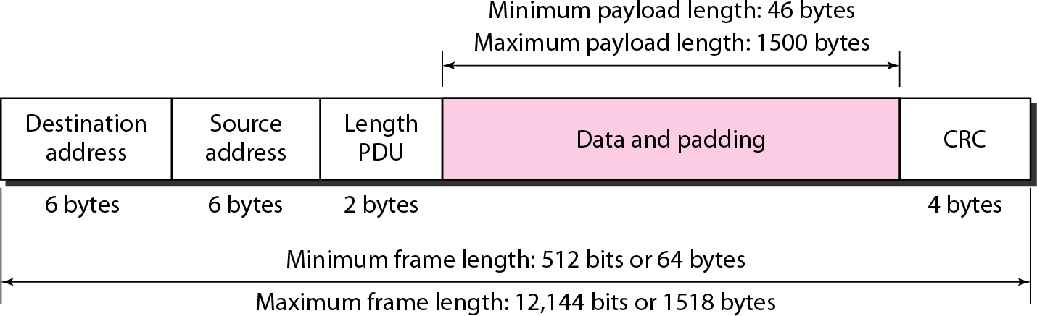
Frame Length – Standard Ethernet
Ethernet has imposed restrictions on both the minimum and maximum lengths of a frame.
The minimum length restriction is required for the correct operation of CSMA/CD.
An Ethernet frame needs to have a minimum length of 512 bits or 64 bytes.
Part of this length is the header and the trailer.
If we count 18 bytes of header and trailer (6 bytes of source address, 6 bytes of destination address, 2 bytes of length or type, and 4 bytes of CRC), then the minimum length of data from the upper layer is 64 - 18 = 46 bytes.
If the upper-layer packet is less than 46 bytes, padding is added to make up the difference.
The standard defines the maximum length of a frame 1518 bytes.
If 18 bytes of header and trailer is subtracted, the maximum length of the payload is 1500 bytes.
Notes:
Access Method. CSMA/CD
Slot time = round-trip time + time required to send jam sequence
Maximum length= propagation speed x slot time/2

Slide 18
Review Questions
What is the minimum and maximum frame length of Ethernet’s frame format?
What is the speed of Fast Ethernet?
10Base-T – Expand
What is the function of last two bit of Start Frame Delimiter?
Mention the main purpose of Autonegotiation.

Slide 19
Review Answers
Frame length: Minimum: 64 bytes (512 bits) Maximum: 1518 bytes (12,144 bits)
100 Mbps
10 – 10 Mbps ; BASE – Baseband; T - Twisted pair cable
The last 2 bits is 11 and alerts the receiver that the next field is the destination address
Main Purpose of Autonegotiation
To allow incompatible devices to connect to one another.
To allow one device to have multiple capabilities.
To allow a station to check a hub's capabilities

Slide 20
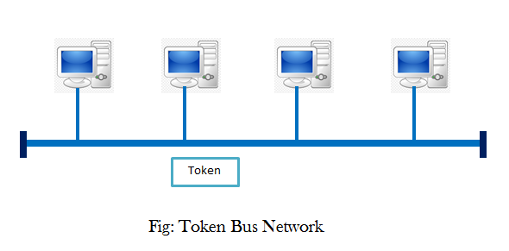
Token Bus
Token Bus IEEE 802.4 is a standard for implementing token ring over virtual ring in LANs.
The physical media has a bus or a tree topology and uses coaxial cables.
A virtual ring is created with the nodes/stations and the token is passed from one node to the next in a sequence along this virtual ring.
Each node knows the address of its preceding station and its succeeding station.
A station can only transmit data when it has the token.
In the Token bus system, the stations are physically organized in bus topology but logically organized in a ring topology
Notes:
A token passes by the stations.
Any station that wants to send a frame must capture the token first, it must be in the possession of the token.
Once the data frame is received by the receiver properly and it comes back to the sender, the sender destroys the frame and releases the free token.

Slide 21
Token Bus
The devices are logically organized into a ring and a token circulates among them.
A device wanting to send something must wait for the token to arrive.
The token contains a destination address that specifies which device gets it.
Each device monitors the bus and reads only those tokens destined for it.
A token is a control frame
In Token Bus Method, a logical ring network is constructed virtually on the bus network

Slide 22
Token Bus
Each node is assigned a sequential number.
A token is transmitted from one node to the adjacent node.
A node that has a request to send a message waits for the arrival of the token that is designated to the node.
Once the node receives the token, it is possible to send a message during the allotted time.
When it finishes sending a message or the allotted time has passed, it issues a token that is designated to its adjacent node. And it waits for the arrival of a new token.
When traffic is low, token cycle time is short.
When traffic is heavy, token cycle time is long.
In the token-bus method, priority control of transmission is performed by the time token control method.
Notes:
When a token circulates at high speed, the network has light traffic, so the possibility is great that a low-priority node can issue a message.
When a token circulates at low speed, the network has heavy traffic. Then a low-priority node has little chance to issue a message.
Example : For the physical layer the token bus uses a broadband coaxial cable used for cable television

Slide 23
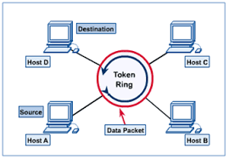
Token Ring
Token Ring - IEEE 802.5 - Communication protocol in a LAN where all stations are connected in a Ring topology.
Each station can directly hear transmissions only from its immediate Neighbour.
Permission to transmit is granted by a message (token) that circulates around the ring.
A station can send data frames only if it holds a token.
The tokens are released on successful receipt of the data frame.
A token is a special frame of 3 bytes that circulates along the ring of stations
TOKEN is a special bit pattern (3 bytes long). There is only one token in the network

Slide 24

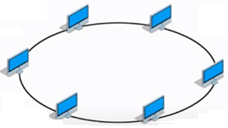
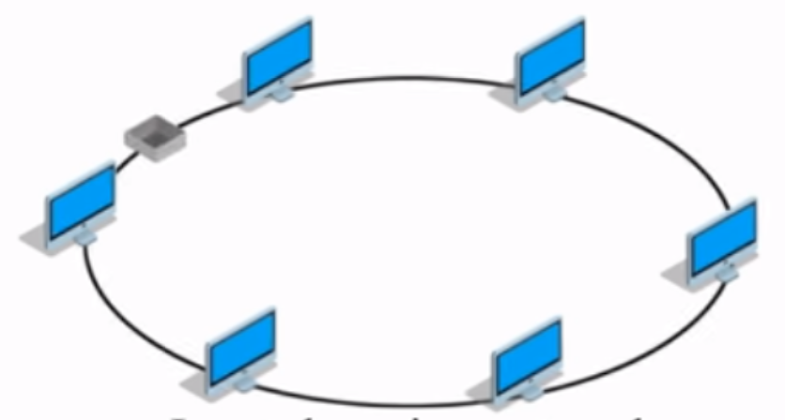
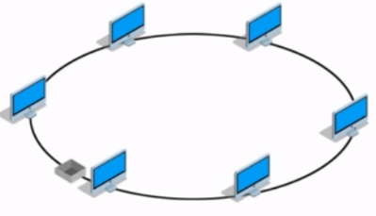
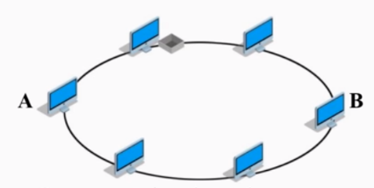
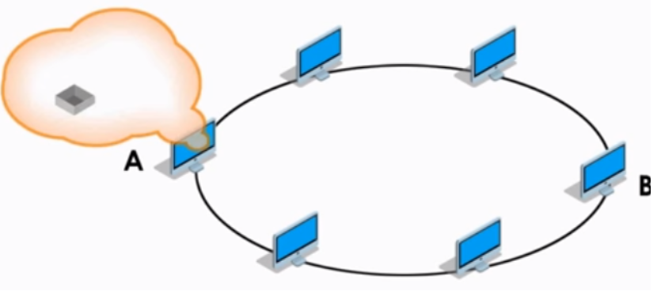
Token Ring Working
Token
❶ Workstations connected in a ring topology
❷ Token Passing
❸
Suppose WS-A wants to transmit some messages to WS- B
❹WS-A catches the passing token to attach the data. Now the empty token becomes a data/control frame

Slide 25
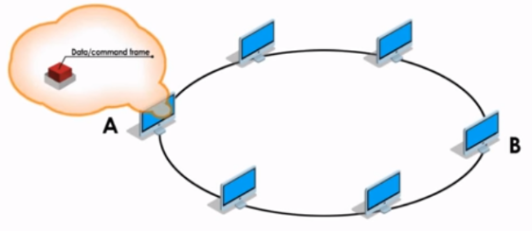
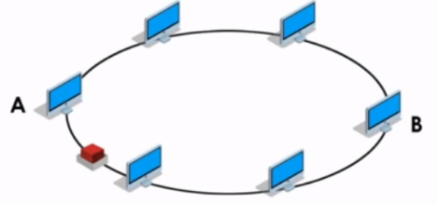
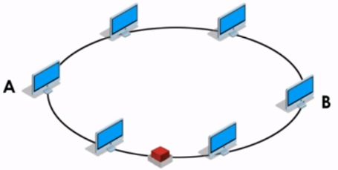
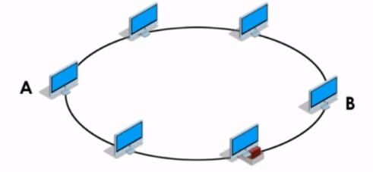
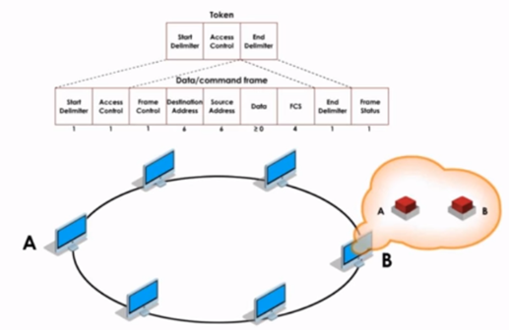
Token Ring Working
❺
❻
WS-A adds the header information like frame control, destination address, source address, FCS and frame status
Now, token along with the message and header is released back to the ring
❼ Every WS checks the destination address against their own address. Passes it on, if the address does not match
❽ If Matched,
WS-B copies the frame.

Slide 26
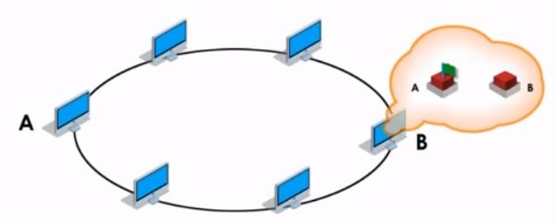
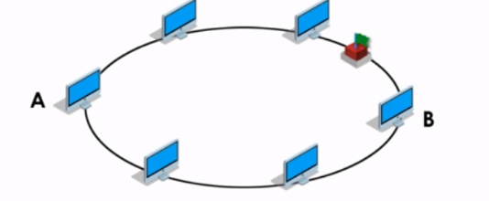
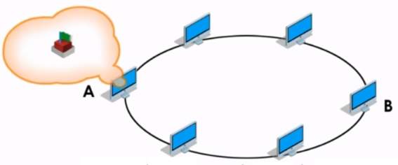
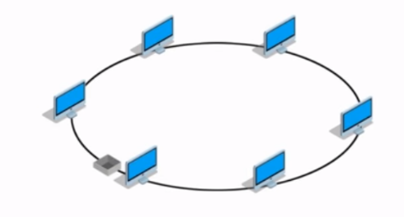
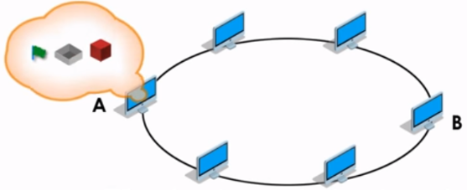


Token Ring Working
❾
❿ Then, releases token with status back to the ring
Changes Frame Status – this provides confirmation that the message has been delivered successfully to the destination
When the token reaches the sender, WS-A removes the message from the token
Then, releases a new empty token back to the network

Slide 27
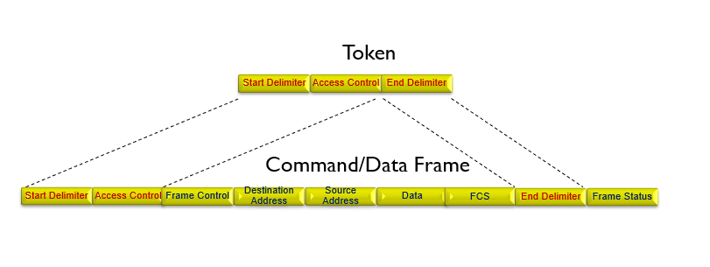
Token and Data Frame

Slide 28
Token Ring
Start Delimiter
Access Control
End Delimiter
TOKEN
Compared with Ethernet, Token Ring has some better features, such as
Token passing access method won’t cause collisions as Ethernet (CSMA/CD) will.
Token ring allows for larger frame size than Ethernet.
Its speed is faster than Ethernet.
Disadvantage :
Very Expensive – so not used widely.
In a token ring, the media access method is called Token Passing
Modes of Operation: Listen Mode , Transmit Mode and By-pass Mode
Notes:
Mode of Operation:
Listen Mode: Node listens to the data and transmits the data to the next node. In this mode there is a one-bit delay associated with the transmission.
Transmit Mode: Node just discards any data and puts the data onto the network.
By-pass Mode: when the node is down., any data is just bypassed. There is no one-bit delay in this mode.

Slide 29
Comparison - Token Bus and Token Ring
Token Ring | Token Bus
It is defined by IEEE 802.5 standard. | It is defined by IEEE 802.4 standard.
The stations are connected by ring topology, or sometimes star topology. | The underlying topology that connects the stations is either bus or tree topology.
The token is passed over the physical ring formed by the stations and the coaxial cable network. | The token is passed along the virtual ring of stations connected to a LAN.
The maximum time for a token to reach a station can be calculated. | It is not feasible to calculate the time for token transfer.
Token ring network does not provide better bandwidth than token bus. | Token bus network provides better bandwidth than token ring.
Token Ring networks are reliable and Star topology is used. | 3. Token Bus networks are unreliable and bus topology is used
Token Ring is expensive than Token Bus | Token bus is cheaper than Token Ring
Designed for the large industries | Designed for the offices.

Slide 30
Review Questions
Token Bus operates under a collision-free environment similar to _________.
2. In Token Ring, the ________ sets the bit in the frame status field to indicate that the frame has been copied.
3. A frame is ______________ at each station in a Token Ring LAN.
a) examined and encapsulated (b) regenerated and discarded
(c) encapsulated and modified (d) examined and regenerated
4. Token bus is physically configured like ___________.
(a) Token ring (b) an Ethernet
(c) FDDI (d) Star

Slide 31
Answers
1. Token Bus operates under a collision-free environment similar to _________. (Token Ring)
2. In Token Ring, the ________ sets the bit in the frame status field to indicate that the frame has been copied. (receiver)
3. A frame is ______________ at each station in a Token Ring LAN.
a) examined and encapsulated (b) regenerated and discarded
(c) encapsulated and modified (d) examined and regenerated
4. Token bus is physically configured like ___________.
(a) Token ring (b) an Ethernet
(c) FDDI (d) Star

Slide 32
Fiber Distributed Data Interface - FDDI
FDDI is a fiber based LAN technology.
FDDI is a token-ring based LAN developed in 1980s.
FDDI Features:
Uses optical fiber as physical medium.
It operates in the physical and MAC layer of OSI network model.
Similar to the IEEE 802.5 token ring but runs in a fiber.
It extends in the range up to 200 km / 120 miles.
Offers data transmission rate of about 100 Mbps
Offers up to 1000 connections
FDDI technology can also be used as backbone for WAN.
FDDI uses three topologies: Ring, Star and Mesh
FDDI became obsolete because of its cost,, complexity and the advent of Fast Ethernet.

Slide 33
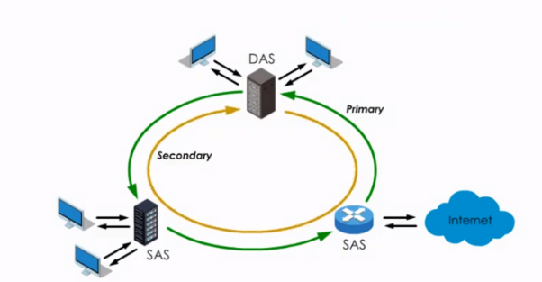
Fiber Distributed Data Interface - FDDI
FDDI consists of dual rings: primary and secondary rings.
Traffic on each ring flows in opposite direction.
Primary ring runs in clockwise direction
Secondary ring runs in counter clockwise direction
On FDDI, a SAS is connected to primary ring and a DAS is connected directly to both the primary and secondary rings,
These stations are concentrators or routers which are the connection points to computer or the Internet
SAS – Single Attachment Station – Used primarily to connect Ethernet LANs or individual servers to FDDI backbones
DAS – Dual Attachment Station - used primarily for network backbones that require fault tolerance.
Primary ring for data and token transmission and a secondary ring that provides backup if the primary ring fails. The primary purpose of the dual rings is to provide superior reliability and robustness.
Notes:
FDDI uses Dual ring

Slide 34
FDDI Basic Principle
Token circulates around the ring in a network.
Any station wants to transmit information holds the token and then transmits the information.
When it finish it release the token in the ring.
The time a station holds the token is called as Synchronous Allocation Time (SAT).
SAT time is variable for each station. The allocation of this time to each station is achieved by Station Management (SMT).
The function of SMT are Ring Control, Ring Initialization, Station Insertion and Station Removal.
The feature of transmitting multiple data frames per token capture is known as a capacity allocation scheme
Components
Single attachment station (SAS)—PCs
Dual attachment station (DAS)—Servers or routers
Concentrator
FDDI uses a timed token-passing technology similar to token ring networks as defined in IEEE 802.5 standard.
FDDI stations generate a token that controls the sequence in which other stations will gain access to the wire.
Notes:
The token passes around the ring, moving from one node to the next.
When a station wants to transmit information, it captures the token, transmits as many frames of information
as it wants (within the specified access period), and then releases the token.
This feature of transmitting multiple data frames per token capture is known as a capacity allocation scheme,
in contrast to the priority mechanism used in the IEEE 802.5 token ring standard.
Every node on the ring checks the frames. The recipient station then reads the information from the frames, and when the frames return to the originating station, they are stripped from the ring.

Slide 35
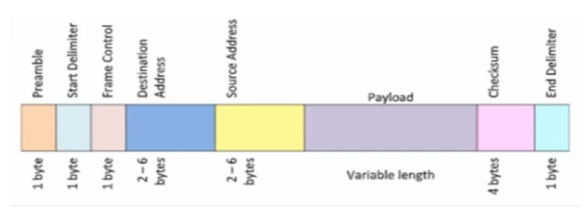
FDDI – Frame Format
Preamble 1byte – Synchronization
Start Delimiter 1byte – Marks the beginning of the frame
Frame control 1byte – Specifies whether it is data frame or control frame
Destination Address 2-6 bytes – Specifies address of the destination station
Source Address 2-6 bytes – Specifies address of the source station
Payload Variable length field that carries the data from the network layer
Checksum 4 bytes – for error detection
End Delimiter 1 byte – Marks the end of the frame

Slide 36
LAN technologies include Ethernet, Token Ring, and FDDI
Ethernet
Most widely used
Token Ring
Primarily used with IBM networks
FDDI
Primarily used for corporate backbones
Good balance between speed, cost, and ease of installation
10 Mbps to 1000 Mbps
4 Mbps to 16 Mbps
Supports longer distances
Data rate around 100 Mbps
FDDI uses a timed token-passing technology similar to token ring networks as defined in IEEE 802.5 standard.
FDDI stations generate a token that controls the sequence in which other stations will gain access to the wire.

Slide 37
Review Questions
Expand : FDDI and CDDI
SAS is a device used in _______
FDDI is a token ring based LAN technology. (True / False)
FDDI and CDDI uses ______ topology.
Token Ring and FDDI both use _______ as an access method.

Slide 38
Answers
Expand : FDDI and CDDI
FDDI – Fiber Distributed Data Interface
CDDI – Copper Distributed Data Interface
SAS is a device used in _______. FDDI
FDDI is a token ring based LAN technology. (True)
FDDI and CDDI uses ______ topology. (dual ring)
Token Ring and FDDI both use _______ (token passing) as an access method.

